Slide 1

Note: The data and information in this document is reflective of a hypothetical situation and client. This document is to be used for KPMG Virtual Internship purposes only.
Sprocket Central Pty Ltd
Data analytics approach
KPMG Virtual Internship – Dhruv Bhatia

Slide 2
Note: The data and information in this document is reflective of a hypothetical situation and client. This document is to be used for KPMG Virtual Internship purposes only.
Agenda
Introduction
Data Exploration
Model Development
Interpretation

Slide 3
Note: The data and information in this document is reflective of a hypothetical situation and client. This document is to be used for KPMG Virtual Internship purposes only.
Introduction
Identify & Recommending High Value Customers
Outline of Problem
Sprocket Central is a company that specializes in high quality bike and accessories.
The Marketing Team is looking to boost sales.
To target 1000 new customers that will bring the highest value to the business.
Approach for Data Analysis
Bike Related Purchases for last 3 years based on Gender ; Sub Categorise – Age Group.
Top Industries contributing the maximum profit and bike related sales.
Wealth Segment by Age Category.
Number of Cars owned in each state.
Customer Classification.

Slide 4
Note: The data and information in this document is reflective of a hypothetical situation and client. This document is to be used for KPMG Virtual Internship purposes only.
Data Exploration
Data Quality Assessment
Key issue dealt with for the data quality issue:
Accuracy |  | Completeness | Consistency | Currency | Relevancy | Validity
Customer Demographic | D.O.B : Inaccurate Age : Missing | Job Tittle : Blanks Customer ID : Incomplete | Gender : Inconsistent Status : Inconsistent | Deceased Customer : Filtered out | Default Column : Delete
Customer Address |  | Customer ID : Incomplete
Transactions | Profit : Missing | Customer ID : Incomplete Online Orders : Blank Brands: Blank |  |  | Cancelled Status Order : Filtered Out | List Price : Format Product Sold Date: Format

Slide 5
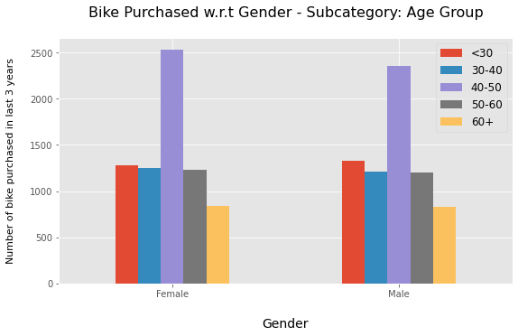
Note: The data and information in this document is reflective of a hypothetical situation and client. This document is to be used for KPMG Virtual Internship purposes only.
Data Exploration
Bike Related Purchases for last 3 years based on Gender ; Sub Categorise – Age Group.
Data shows age group 40-50 has high count in terms of bike purchased in last 3 years within that Female ratio a bit higher.
But in totality Average Males have 1% higher bike related purchases as compare to Females in the last 3 years

Slide 6
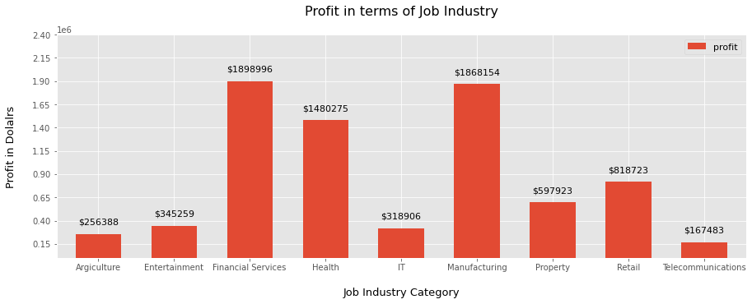
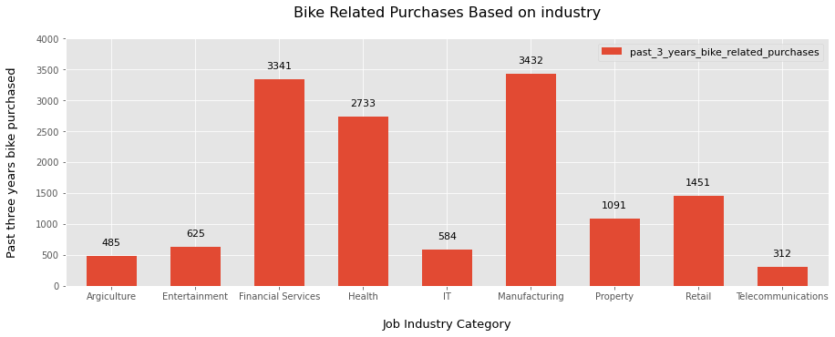
Note: The data and information in this document is reflective of a hypothetical situation and client. This document is to be used for KPMG Virtual Internship purposes only.
Data Exploration
Top Job Industry Contributing to Maximum Profit & Bike Related Purchases
The top 3 industry sectors bringing in highest profit are : Financial Services ($ 18.98 lakhs) ; Manufacturing ($ 18.68 lakhs) ; Health ($ 14.8 lakhs).
These can be obvious as most of these industry sectors are based within the city or on the outskirts of the city therefore prefer bikes for consuming.
Most of the industry sectors have returned less than $ 1,000,000 in profits.

Slide 7
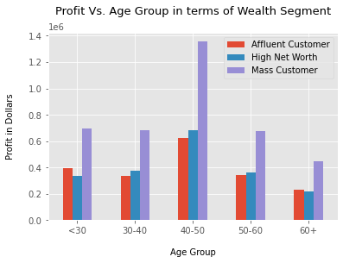
Note: The data and information in this document is reflective of a hypothetical situation and client. This document is to be used for KPMG Virtual Internship purposes only.
Data Exploration
Profit of Wealth Segment by Age Cluster
Overall the Mass Customer Segmentation makes the highest profit across different age clusters.
The Mass Customer aged between 40-50 are likely to bring more profit for the company compared to other age clusters.
This also indicates a trend of buying power, as the buying power increases over time till 50 and then see’s a decline in buying power, thus leading to lower profits.

Slide 8
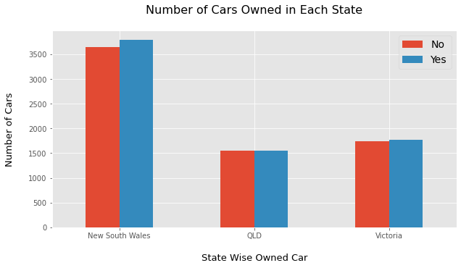
Note: The data and information in this document is reflective of a hypothetical situation and client. This document is to be used for KPMG Virtual Internship purposes only.
Data Exploration
Number of Cars Owned in Each State
Out of three states, New South Wales, could be potential market opportunities for the company.
The New South Wales has the highest potential as the number of people that own car is almost equal to the people who don’t own cars which shows that there is opportunity to find value customers there.

Slide 9
Note: The data and information in this document is reflective of a hypothetical situation and client. This document is to be used for KPMG Virtual Internship purposes only.
Model Development
Customer Classification – Targeting High Value Customers
These are the high value customers that should be targeted from the new list:
Who are currently living in New South Wales and Victoria.
Aged between 40 – 50.
Working in Financial Service, Manufacturing and Health.
Most of the high value customers are female compared to male.

Slide 10
Note: The data and information in this document is reflective of a hypothetical situation and client. This document is to be used for KPMG Virtual Internship purposes only.
Interpretation
Summary Table for High Value Customers
List of few customers that will come under the high value customer classification
Customer ID | Bike Related Purchases for the last 3 years | Age | Job Industry | Wealth Segment | Owns Cars | State
1842 | 445 | 44 | Financial Services | Mass Customer | No | New South Wales
2001 | 168 | 44 | Manufacturing | Mass Customer | Yes | New South Wales
650 | 486 | 44 | Health | Mass Customer | No | New South Wales
3297 | 234 | 46 | Manufacturing | Mass Customer | No | Victoria
50 | 266 | 41 | Manufacturing | Mass Customer | Yes | New South Wales

Slide 11
Note: The data and information in this document is reflective of a hypothetical situation and client. This document is to be used for KPMG Virtual Internship purposes only.
Model Development
Targeted marketing strategies using RFM-analysis
RFM-analysis is a multi-dimensional scoring method focusing on the following three parameters:
Recency (R) of a customer: Days since the last purchase.
Frequency (F) : Number of purchases, e.g., in 6 months.
Monetary (M) - The total turnover of a customer: Sum of sales, e.g., in 6 months.

Slide 12
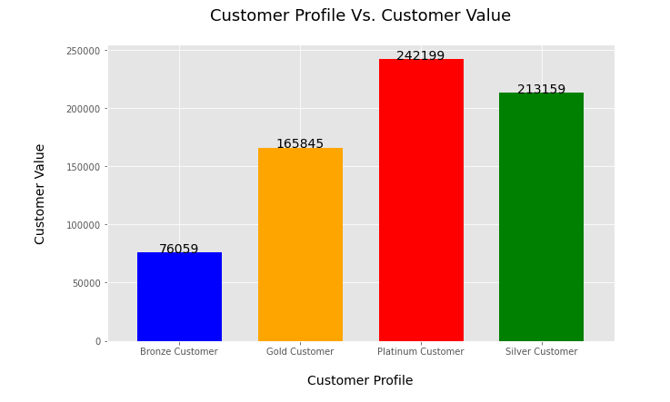
Note: The data and information in this document is reflective of a hypothetical situation and client. This document is to be used for KPMG Virtual Internship purposes only.
Interpretation
Customer Profile Vs. Customer Value – RFM Analysis
The Platinum Customers holds high value as they have RFM value greater than 411.
Lot of customers are Platinum Customers, and the company should go for them because, they hold higher customer value compared to all the other customers.

Slide 13
Note: The data and information in this document is reflective of a hypothetical situation and client. This document is to be used for KPMG Virtual Internship purposes only.
THANK YOU

